Slide 1

Leveraging Grant Funds to Build CCDPH’s Data Capacity and Advance Health Equity
Alfreda Holloway-Beth, PhD, MS
Director of Epidemiology
Notes:
Next slide

Slide 2
About CCDPH and Data Capacity Strategic Plan

Slide 3


CCDPH: Key Approaches to Advancing Health for All
Data Capacity
Assess and understand the community’s health status and the determinants of health, assets and resources.
Develop comprehensive plans to address major health indicators.
Monitor, measure, and evaluate agency and community efforts.
Activity 2.3
Increase availability, accessibility & understanding of health behavior & outcomes data by race & ethnicity.

Slide 4
2018 – 2022 Strategic Plan: Focus Areas
Health Equity
Strategic Communication
Resource Development
Data Capacity
Priority Initiatives
Notes:
Data Capacity: Increase CCDPH’s capability to leverage data to drive, inform, evaluate, & promote CCDPH’s work & to better inform, support, & respond to the needs of key stakeholders & the community.

Slide 5

2018 – 2022 Strategic Plan: Focus Areas Data Capacity
CDC Health Equity Grant CCDPH Epidemiology
CSTE Data Science Team Training (DSTT) Program CCDPH Epidemiology + Communicable Disease Units
IDPH Crisis Grant UIC PHAME + CCDPH Epidemiology Unit
Data Capacity
Notes:
Data Capacity: Increase CCDPH’s capability to leverage data to drive, inform, evaluate, & promote CCDPH’s work & to better inform, support, & respond to the needs of key stakeholders & the community.

Slide 6
CDC Health Equity Grant
National Initiative to Address COVID-19 Health
Disparities Among Populations at High-Risk and Underserved
Notes:
CCDPH is one of 107 grant recipients.

Slide 7
CDC Health Equity Grant 2021-2023
Cook County Health Survey, 2022 RTI International + Chicago DPH
Youth Risk Behavioral Survey, 2022 ICF Macro
Rapid Assessment Data Collection Qualtrics
Cook County Health Atlas Metopio + UIC PHAME
Data Capacity
Notes:
Data Capacity: Increase CCDPH’s capability to leverage data to drive, inform, evaluate, & promote CCDPH’s work & to better inform, support, & respond to the needs of key stakeholders & the community.

Slide 8
Cook County Health Atlas
The Cook County Health Atlas will be an interactive tool to identify and provide tools for exploring and communicating environmental, neighborhood and other social determinants of health.
Some of the aims of this project are to:
To assess curated data and its data visualization platform as well as public health data sources to inform our decision-making process of population measures/indicators the atlas.
To coordinate with Metopio to review wireframes for mocking up the data visualization design for the Cook County Health Atlas.
To coordinate with Metopio on data imports for public health primary and secondary data.
To develop a review and approval process. Fifth, to develop communication and promotion plans that will inform the general public, suburban Cook County residents, and various stakeholders.
URL will be
www.cookcountyhealthatlas.org
Notes:
The Cook County Health Atlas will be an interactive tool populated by public health hospitalization, emergent care, and vital statistics data, US Census and American Community Survey data and our two primary data sources that include the Suburban Cook County Health Survey, as well as the SCC Youth Risk Behavioral Survey. The goal of this collaboration with the University of Illinois Chicago School of Public Health, Metopio, and CCDPH is to better understand the health of residents within Suburban Cook County. Information that will be provided on the Health Atlas will help to identify health concerns across each of the 126 municipalities within Suburban Cook County as well as to identify and provide tools for exploring and communicating environmental, neighborhood and other social determinants of health.
There are several phases with this project: first, is the exploration and discovery phase which is intended to assist with the development of indicators and measures; second, identifying geospatial units of analysis such as census tract, suburban Cook County, CCDPH public health districts, Commissioner districts, etc.; third, identifying the geospatial layer of each Public Health data source; fourth, using a descriptive statistic framework CCDPH Epi unit will calculate the rates, percentages, proportions, and provide count data for measures and indicators at various geospatial layers; fifth, primary data collection of healthy and risky behaviors,
The remainder of this document provides additional information concerning the project’s scope of work including a timeline and descriptions of deliverables to ensure successful implementation of the work plan and achievement of the project’s targets and goals. The time period to be covered by this scope of work beginning January 1, 2022 through December 31, 2023.
This effort will coordinate activities and leverage resources with other ongoing projects including: a year-long data science team training (DSTT) program CCDPH’s epidemiology and communicable disease units were awarded by the Council of State and Territorial Epidemiologists (CSTE) and Suburban Cook County Health Atlas design and deployment project.

Slide 9
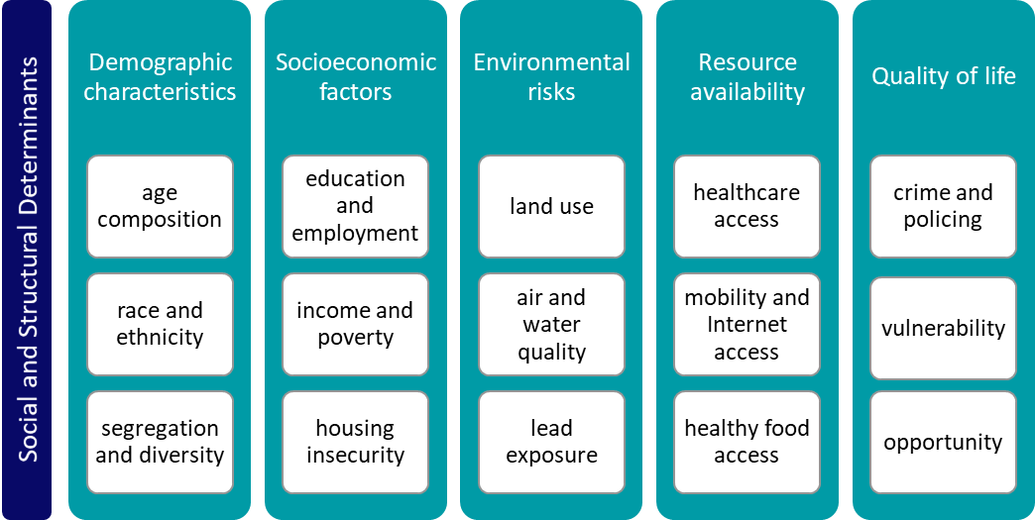
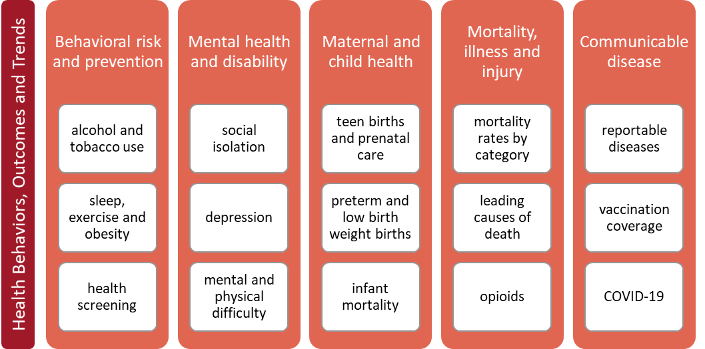
Cook County Health Atlas Indicator Categories, Topics and Data Sources
CCDPH CHSA 2021 Sections, Categories and Topics
CCDPH
Metopio
Cook County Health Survey
ACS
YRBS
BRFSS
Hospitalization
CDC
Infectious Disease
EPA
Medical Examiner
904 indicators drawn from 92 data sources
Vital Statistics
Notes:
Metopio offers x number of topics (i.e., indicators) across x categories drawing from 92 data sources.

Slide 10
Next Steps
Notes:
CCDPH is one of 107 grant recipients.

Slide 11
Cook County Health Atlas – Phased Data Rollout
Phase 1
- CHSA indicators
- Reportable infectious diseases
- Annual opioid deaths
Phase 2
- Mortality
- Natality
Phase 3
- Hospitalization
Phase 4
- Cook County Health Survey
- Youth Risk Behavior Survey
Notes:
Phase one in mid-May 2022 (CHSA indicators; limited reportable infectious diseases; annual opioid death and select Metopio-curated data). Phase two in July 2022 (mortality and natality 2018-2020; and select Metopio-curated data); Phase three (hospitalization data, 2016-2020; and select Metopio-curated data); and Phase four (Cook County Health Survey data, 2022; and select Metopio-curated data).
Technical Assessment
Development
Data Management
Health Atlas Technical Assessment activities support research and engagement, including interviews with staff, stakeholders, and super users, as well as server costs and systems administration costs. Health Atlas Development activities requests funds to support engineering activities responsible for developing Atlas Indicators, Data taxonomy and organization, Pages for places, Pages for topics, Free-explore maps, Free-explore charts, Analytics tools, Search, Download, Account management, and API. These funds also cover Testing and Feedback costs, and staged for release the core site with functionality listed above. Health Atlas Data Management funds cover the costs of data assessment and management activities, including data preparation, formatting, uploads and analysis of all relevant CCDPH data, Healthy Cook County survey data and data developed or curated by the PHAME Center.

Slide 12
Questions?

